Slide 1
Indicators of Heart Disease Group – Health Statistics
-Group Members
Sameer Savan Tumarada
Ankit Prashant Nayak

Slide 2
Table of Content
Introduction
Key Insights
Demographic & Visualization (01-06)
Conclusion

Slide 3
Introduction
Analysing the CDC's 2022 survey of 240000+ U.S. adults, we aim to highlight key risk factors and behaviours impacting heart disease. Through advanced analytics, we seek to identify crucial health determinants and strategies for improvement, aiming to reduce heart disease rates and enhance public health.

Slide 4
Key Insights
Key insights from the presentation are:
1. Obesity, angina, and depression significantly raise the likelihood of heart disease.
2. Smoking and arthritis are prevalent among heart disease patients and are critical risk factors.
3. Diabetes and inactivity are strongly associated with cardiovascular issues.
4. Targeted interventions and lifestyle changes are essential to reduce heart disease risks..
5. Proactive management of these factors can greatly enhance overall well-being and prevent heart disease

Slide 5
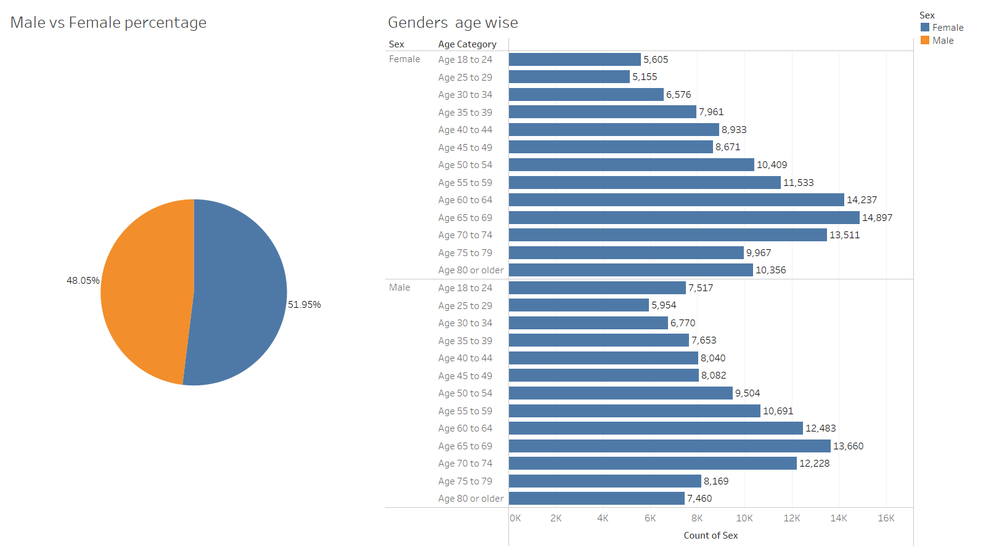
Gender Distribution
Above pie chart shows that females are more than males in the sample data population.
In this chart, we can see that the Mostly individuals are aged around 65-69

Slide 6
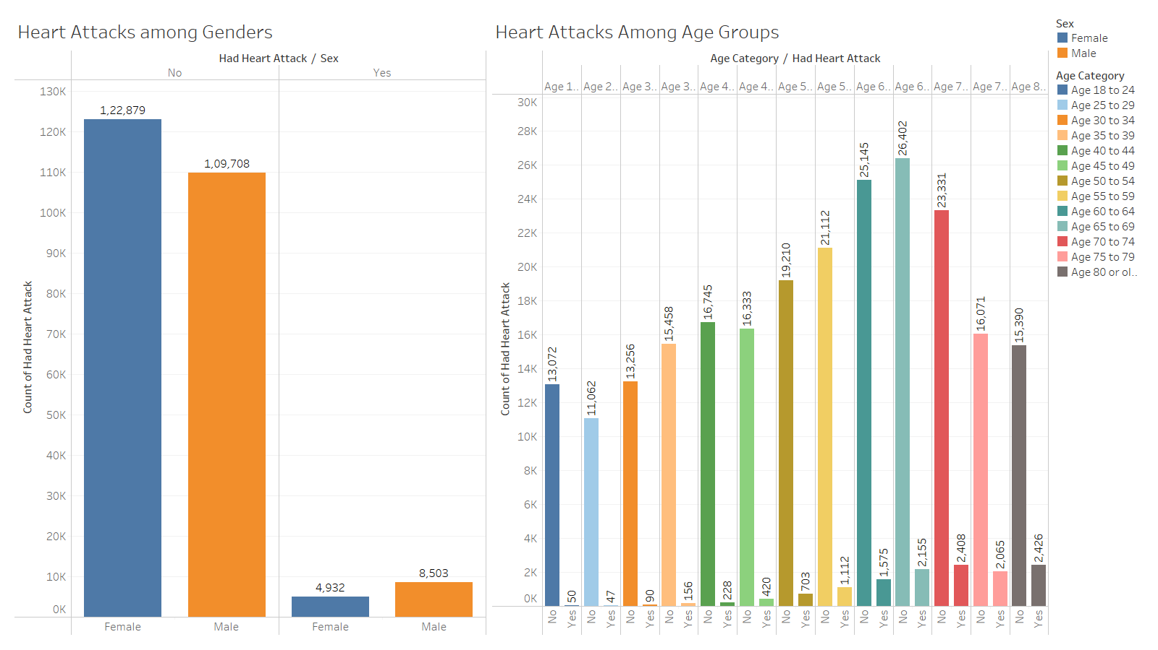
Heart Attack Prevalence by Gender and Age
Many individuals did not experience any heart disease. However, among those who did, the majority were males.
The individuals who are above 80 have experienced heart diseases among different age groups. However, those who are aged between 18-24 had a bit of experience with heart diseases

Slide 7
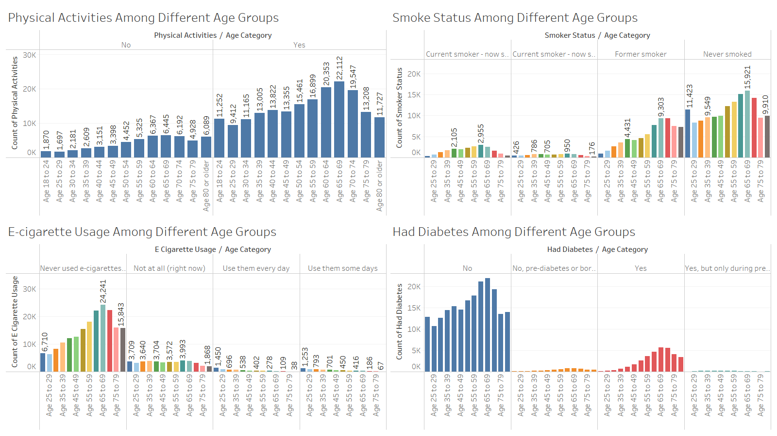
Health Status Among Different Age Groups
Physical activity peaks at 65-69 but declines after 80; smoking prevalent at 60-64, decreases by 70-74, while e-cigarette use peaks at 18-24; diabetes rates highest at 70-74, lowest among 18-30.

Slide 8
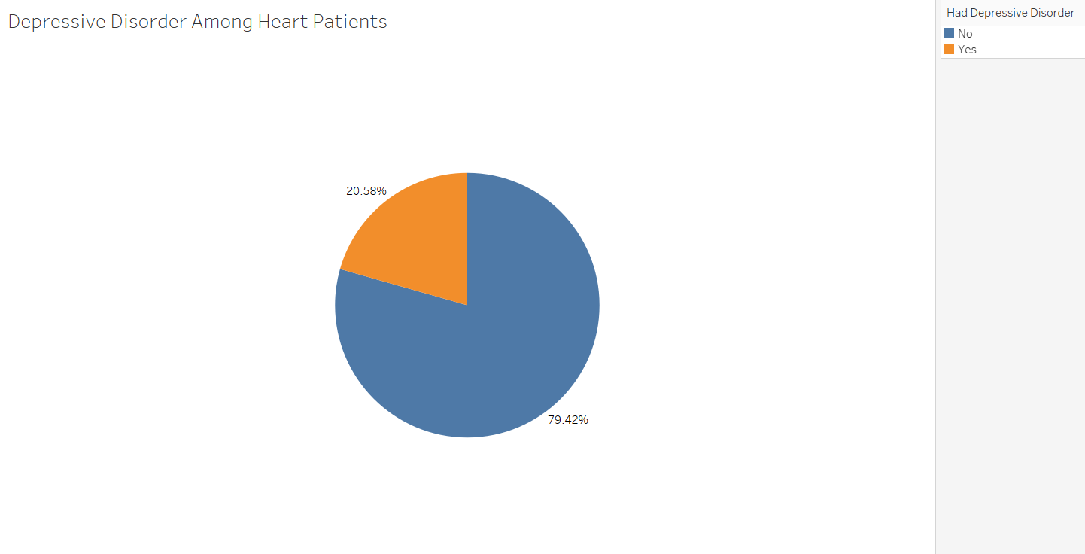
Prevalence of Depressive Disorder Among Heart Patients
This pie chart shows that about 20% of heart patients also suffer from depression, If we consider all the heart patients, then one out of four people are facing depressive disorders.

Slide 9
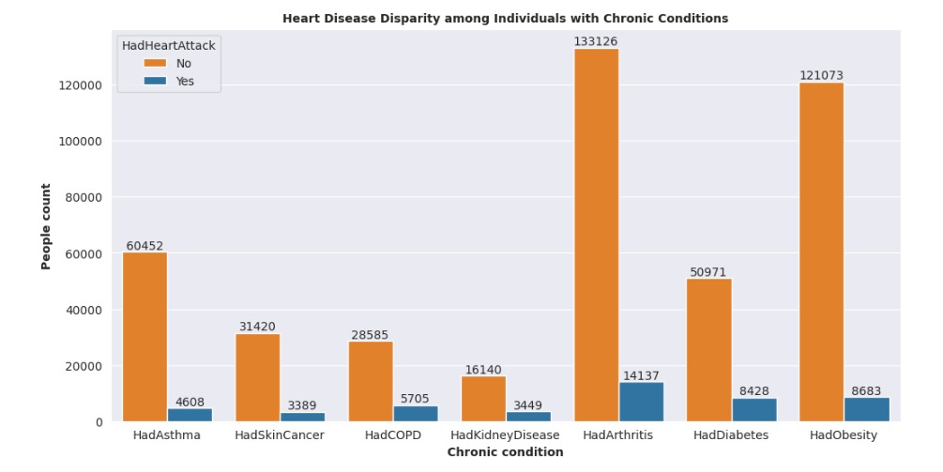
Here you can see that many people reported heart disease who previously had problems of arthritis, diabetes, and obesity.

Slide 10
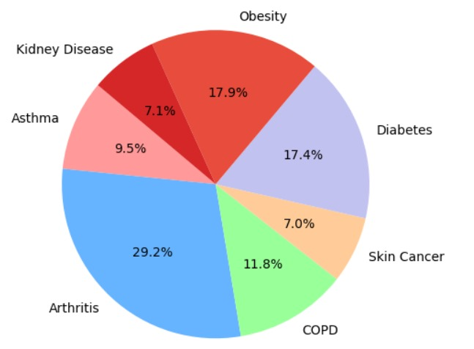
Prevalence of Chronic Conditions Among Heart Patients
This pie chart shows that arthritis, obesity, and diabetes are the most common comorbid conditions in heart disease patients, emphasizing the need for integrated care approaches.

Slide 11
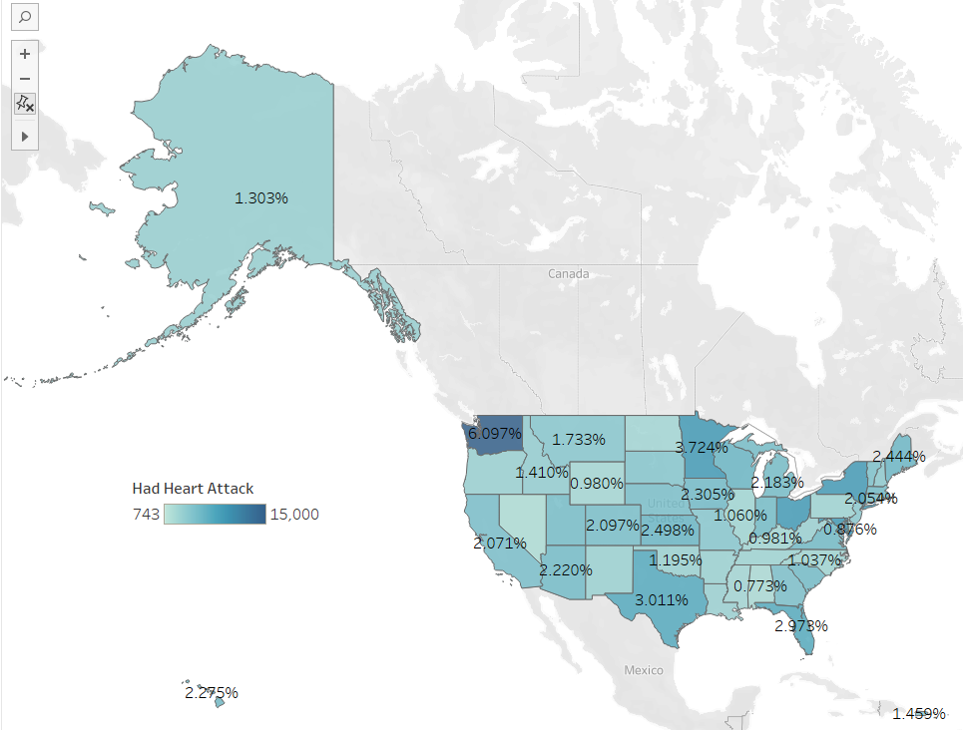
Count of Heart Attacks Along States
In this map, Washington exhibits the highest prevalence of heart attacks, with a recorded percentage of 6%.

Slide 12
Conclusion
After a thorough analysis of the dataset, it is evident that several key factors significantly influence the likelihood of heart disease. These include obesity, angina pain, depressive disorder, smoking, arthritis, diabetes, and lack of physical activity. Addressing these factors through targeted interventions and lifestyle modifications is crucial in mitigating the risk of heart disease. By focusing on prevention strategies and promoting healthier behaviors, individuals can take proactive steps toward safeguarding their cardiovascular health and overall well-being.

Slide 13
Thank You !

